Slide 1
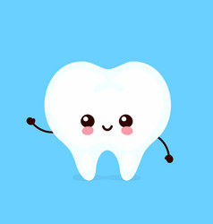
Providing Oral Care and Education to Your Patients
DH Students: Cassondra & Maddie

Slide 2
Learning Objectives
Understand the roles of the DH verse the nurse
Understand the importance of oral health
Understand the basics of oral disease etiology
Understand how to identify signs of oral disease
Understand how to prevent oral disease
Understand client specific adaptations
Understand conditions to consider

Slide 3

The Role of a Dental Hygienist
DENTAL HYGIENISTS are regulated health care professionals that primarily focus on oral health promotion and oral disease prevention.
Hygienists work with clients to determine their current oral health status, provide care to improve their oral health, and help clients maintain the health of their mouth/teeth.
Some examples of care that a dental hygienist may provide includes taking radiographs, performing periodontal assessments, providing oral health coaching to promote effective home care, debridement of calculus from teeth, polishing, whitening, etc.
Notes:
C

Slide 4
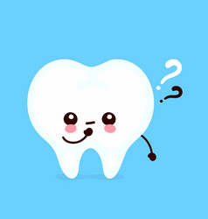

The Importance of Oral Care
Effective oral care is the only way to prevent things like, cavities, gingivitis, periodontal disease, and reduces the risk of more serious conditions like heart disease, stroke, etc.
Neglecting oral care impacts foods being eaten and can lead to tooth decay, pain, an increased risk of needing dentures or partials, lost teeth, or contribute to overall declining health.
Lack of oral care can also lead to complications in persons who have conditions like uncontrolled diabetes, and vice versa as diabetes is a leading factor for periodontal
disease.
Notes:
C

Slide 5
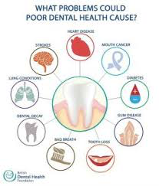
Relationship Between Oral and Systemic Health
The relationship between oral health & systemic health is VERY important as when your mouth is unhealthy and diseased then the bacteria that forms in your mouth can travel through the infected areas and into your bloodstream or down your esophagus, which can then cause further complications for the rest of your body.
Notes:
M

Slide 6
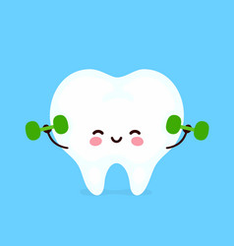
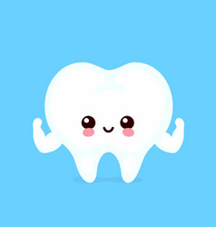
The Role of a Nurse
Nurse’s are caregivers who prevent and treat illnesses and injuries. Nurses provide a wide array of medical needs for their patients and are also able to provide oral health care.
While nurses are NOT able to provide clients with extensive oral health care, they ARE able to provide basic oral scans, tooth or denture brushing, as well as be able to recognize if something is wrong and when the client should be referred to see a dental professional.
Notes:
M

Slide 7
The Basics of Oral Disease Etiology

Slide 8
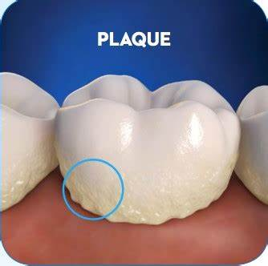
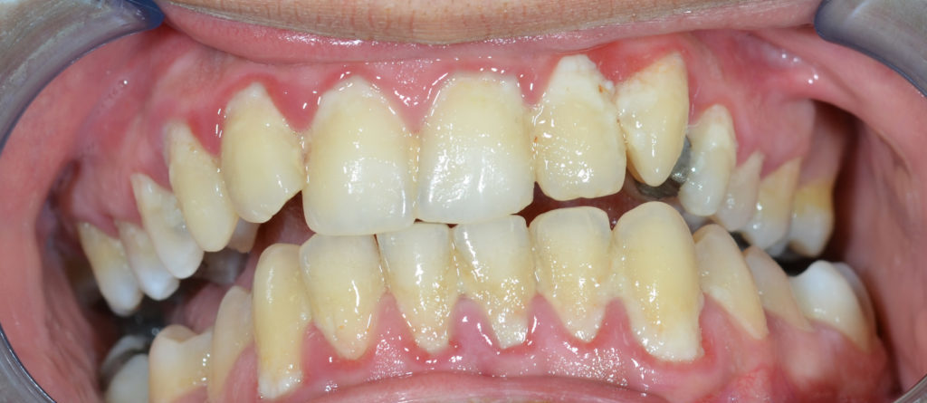
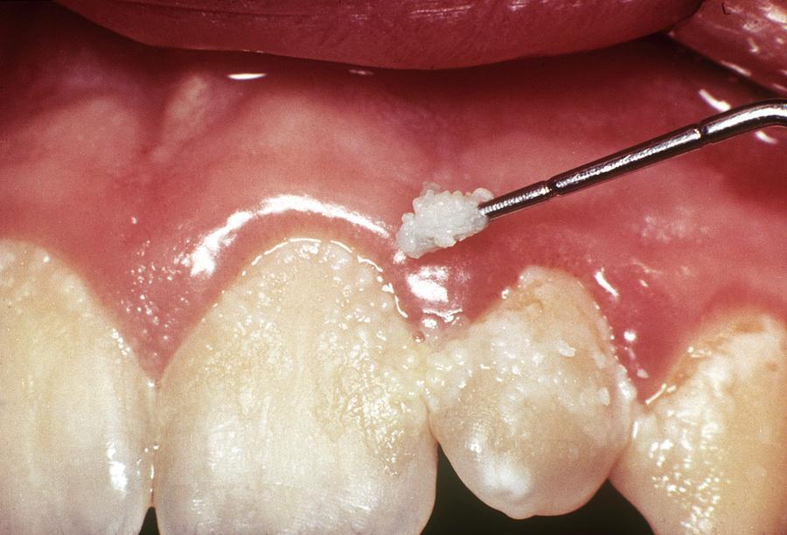
What is BIOFILM?
BIOFILM is a soft, bacterial film that constantly forms on surfaces within the mouth; more commonly known as plaque.
Biofilm is a complex arrangement of bacteria, and these bacteria can harm the surfaces they reside on.
Notes:
https://synergydental.org.uk/tag/plaque/
C

Slide 9
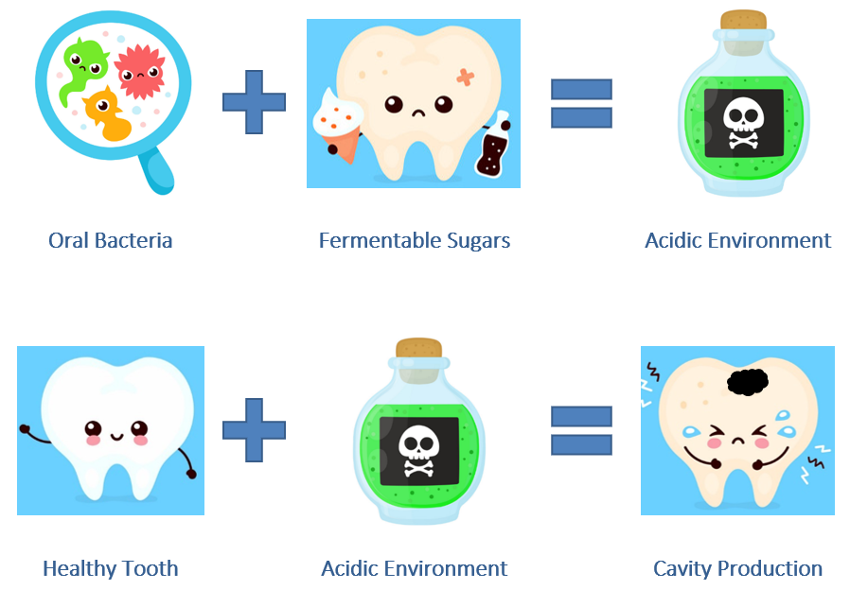
How Biofilm Affects the TEETH
The bacteria within biofilm can interact with fermentable carbohydrates within the oral cavity. This interaction increases oral acidity.
The acidity within the biofilm can slowly wear away the outer layer of the teeth (the enamel) and progress the dental caries; more commonly known as cavities!
Notes:
C

Slide 10
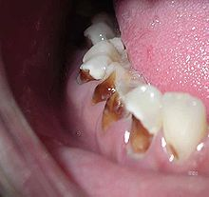
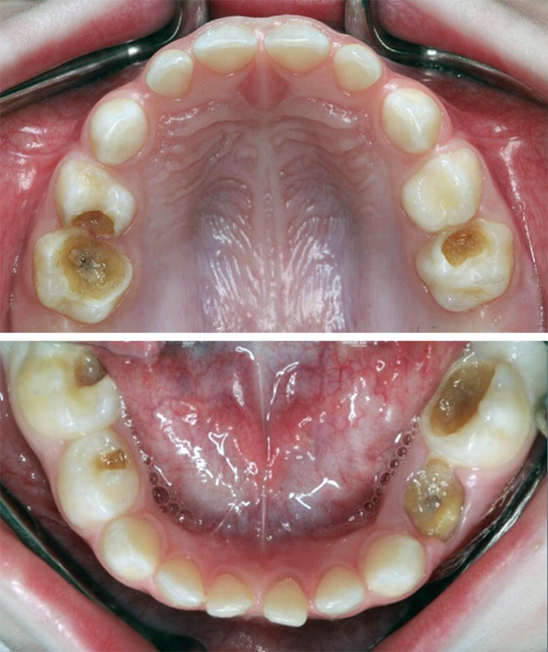
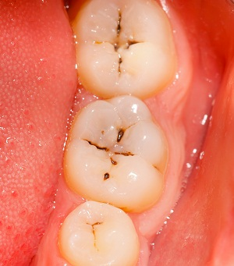
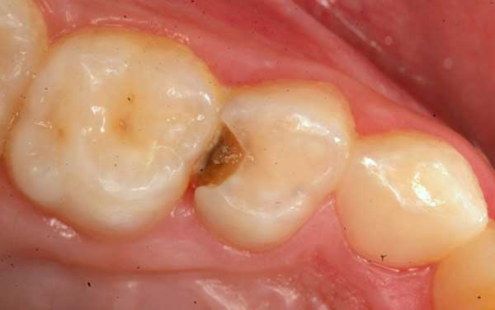
How Biofilm Affects the TEETH CONT...
The following are examples of dental decay.
When found, diagnosis is NOT within the DH or nursing scope of practice! Indicate potential decay, and refer to a dentist!
Notes:
C

Slide 11
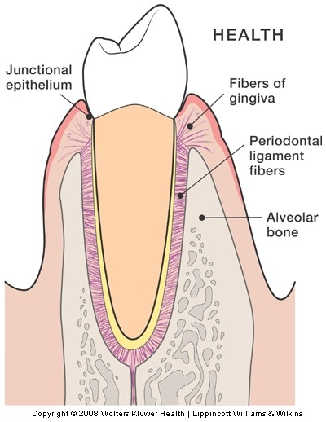
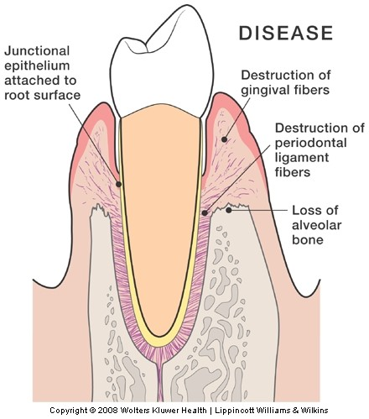
How Biofilm Affects the GUMS
The bacteria within biofilm can irritate the gums (AKA gingiva) and cause inflammation. Calculus (hardened plaque bacteria; AKA tartar), can become embedded under the gumline and cause inflammation.
Inflammation causes destruction of:
  Fibers within the gums (gingival fibers)
  Ligaments that surround and support the teeth (periodontal ligaments)
  The bone that holds the teeth within the jaw (alveolar bone)
Notes:
M

Slide 12
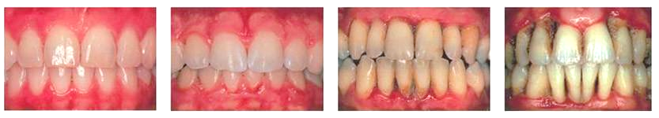
How Biofilm Affects the GUMS CONT...
GINGIVITIS → stage where there is ONLY destruction of gingival fibers.
  This stage is reversible
PERIODONTITIS → stage where there is ALSO destruction of periodontal ligaments & alveolar bone
  This stage is irreversible
Signs → Gums that are red, inflamed, swollen, and/or bleeding, and/or teeth that are mobile.
When found, diagnosis is NOT within the DH or nursing scope of practice! Indicate potential gum disease, and refer to a dentist!
Notes:
M

Slide 13
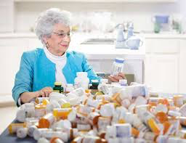
Risk Factors for Oral Disease
Polypharmacy → Due to taking many medications that can affect the oral cavity and cause xerostomia (dry mouth) which can then increase their risk for dental decay (cavities).
Irregular dental care → Due to not being able to afford or have access to dental care.
Irregular oral scans → Due to no one checking in their mouths as often as they maybe should, leaving disease go undetected.
Notes:
M

Slide 14
REVIEW TIME!
Can You Tell Us What You Remember?
What is Biofilm?
Why is it important to remove biofilm?
Why is oral care important?
Notes:
M

Slide 15
Identifying Signs of Oral Disease

Slide 16
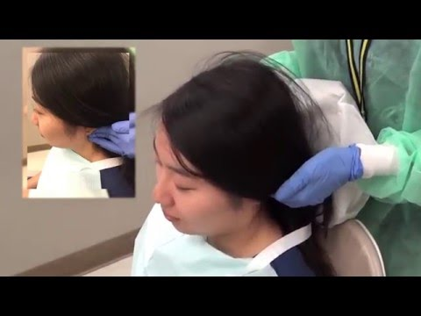
How to Perform an Intraoral Scan
Notes:
C

Slide 17
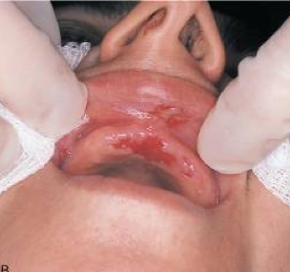
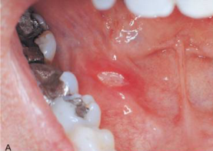
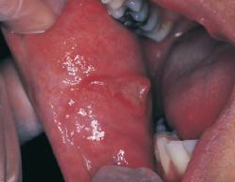
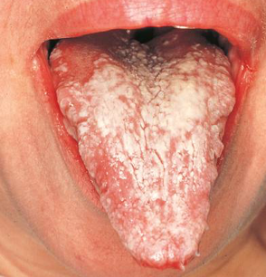
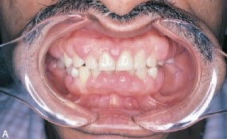
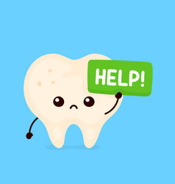
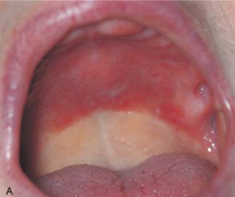
Potential Abnormal Findings from an Oral Scan
Notes:
Pemphigus Vulgaris
Ulcers, Canker Sores, Aphthous Stomatits
Chronic Hyperplastic Candidiasis
Denture Stomatits
C

Slide 18
PRACTICE TIME!
We are now going to practice:
Performing an intraoral scan
Notes:
C

Slide 19
Prevention of Oral Disease

Slide 20
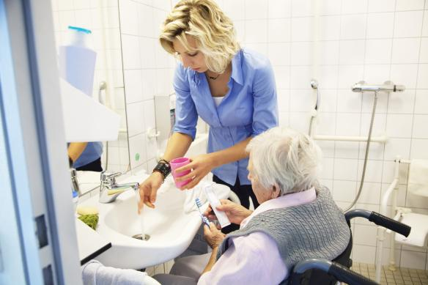
How Can Oral Disease be Prevented?
Oral disease can be prevented through:
  Regular adequate biofilm removal (through brushing and interdental aids)
  Adequate saliva stimulation
  Proper care for dental appliances (crowns/bridges/implants) and dentures
  Regular visits to a registered dental hygienist and dentist
  Fluoride treatments provided in dental offices, and authorized clinics and physicians offices
  Regular intraoral scans to identify problems at early stages
Notes:
M

Slide 21
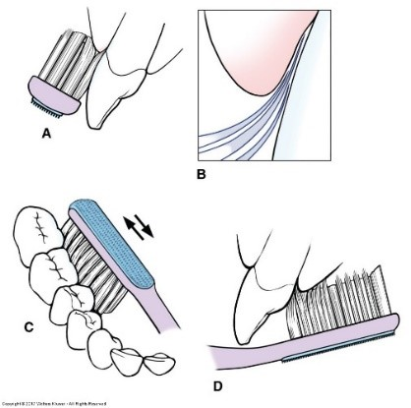
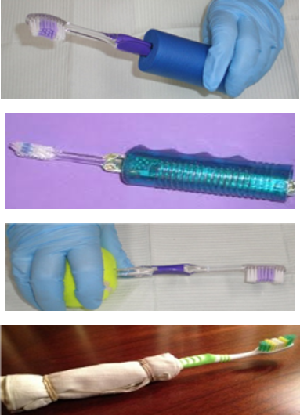
Brushing Technique for Biofilm Control
BASS TECHNIQUE
  Angle bristles under the gumline
  Use a vibrating stroke across 2-3 teeth with light pressure
** PLEASE NOTE ** → If it is hard for a client to hold a toothbrush, they can increase surface area for grip with the use of a tennis ball, bike handle, or washcloth!
Notes:
M

Slide 22
PRACTICE TIME!
We are now going to practice:
Brushing
Notes:
M

Slide 23
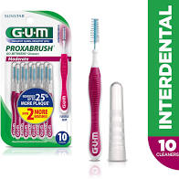
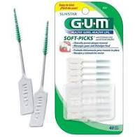
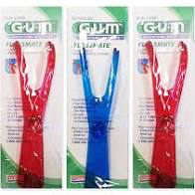
Interproximal Aids
Proxabrush Soft picks Floss Holder
Notes:
C

Slide 24
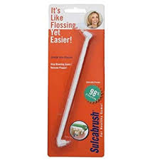
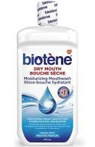

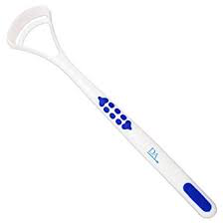
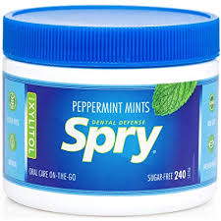
Beneficial Oral Aids and Products
Sulcabrush → Used around the gum line to help with the removal of biofilm.
Tongue scraper → Used to clean the tongue so bacteria does not accumulate on the tongue.
Biotene → For people who have dry mouth as well as those who wear dentures.
Xylitol → For clients who experience dry mouth (Pur Gum, xylitol mints). Only 6-10g/day should be used as more than 20g/day can cause gas and diarrhea.
Notes:
C

Slide 25
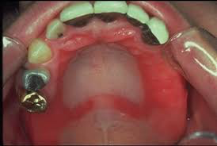
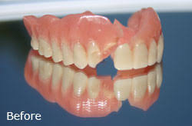
Denture Care
It is good to discuss with clients that they should be taking their dentures OUT at night time.
Have a look in their mouths for any red unusual spots that may indicate an issue in their mouth.
Inspect their denture for any breaks or fractures (this will call for a referral to a denturist or their dentist to fix).
Notes:
M

Slide 26
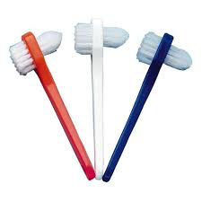
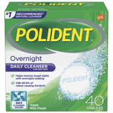
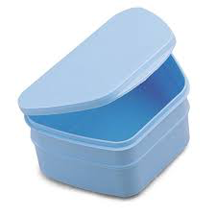
Denture Care CONT...
Brush the dentures every day with a denture brush to ensure that biofilm is removed, as plaque can still form on false teeth!
Ensure that the gums of the client are getting brushed with a soft toothbrush or are being massaged as well to keep this tissue healthy.
Using the product Polident add the tablet in their denture container and fill with water and let the dentures sit in the solution overnight.
Before placing the denture back into a client’s mouth the denture should ALWAYS be rinsed off to ensure that there is no solution left on it (TIP - place a towel at the bottom of the sink in case it drops to prevent any potential damage to the denture).
Notes:
M

Slide 27
PRACTICE TIME!
We are now going to practice:
Using interproximal aids
Using a sulcabrush
Brushing a denture
Notes:
C

Slide 28
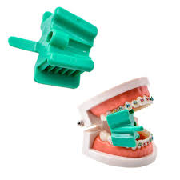
Strategies for the Physically Incapable Client
Ensure that you are patient and make your client comfortable.
Treat them as you would any other person as they are a person first and someone with a disease second!
Bite blocks are a good tool to have as they can help you look in their mouth and it ensures that your clients mouth stays open without them accidentally closing and biting your hand.
Have some distractions that someone could play with or just touch such as pictures, pamphlets, extra toothbrush or any aids you will give them.
Notes:
C

Slide 29

Conditions with Strong Associations to Oral Health
Aspiration pneumonia → Lung infection due to food/liquid that stays in the airway enters the lungs and harmful bacteria grows
Dysphagia → Disorder resulting in difficulty swallowing due to various neurological/structural impairments
Diabetes → If it is uncontrolled clients are at an increased risk for infection due to the body’s inability to heal adequately
Cardiovascular disease → When debris and plaque build in clients pockets bacteria enters and then can enter the bloodstream through infection and cause a blockage in their arteries
Notes:
M

Slide 30
Questions?

Slide 31
Thank You for Listening and Caring!!

